Slide 1

COMPUTER NETWORK AND TOPOLOGIES:
PRESENTER : IRFAN ALI QURESHI

Slide 2

WELLCOME:

Slide 3

What will we learn here ?
Network definition
Use of network
Network types
Network topologies
Types of topologies

Slide 4
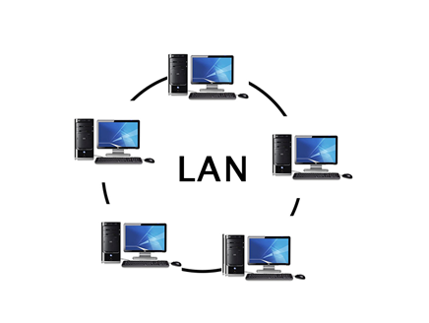
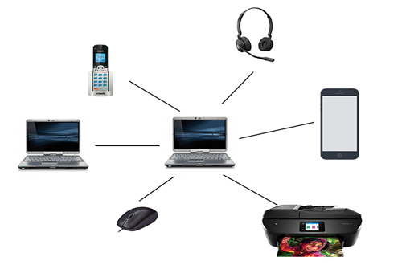
What is network?
It is a system in which multiple computer are connected to each other to share INFORMATION and RESOURCES by either WIRED and WIRELESS media system.

Slide 5

Use of network:
We use various technologies in our daily life such as email, instant messaging, online chat voice and video telephone calls , sending money ,browsing and shopping online.
These all our activities are possible due to networking.

Slide 6
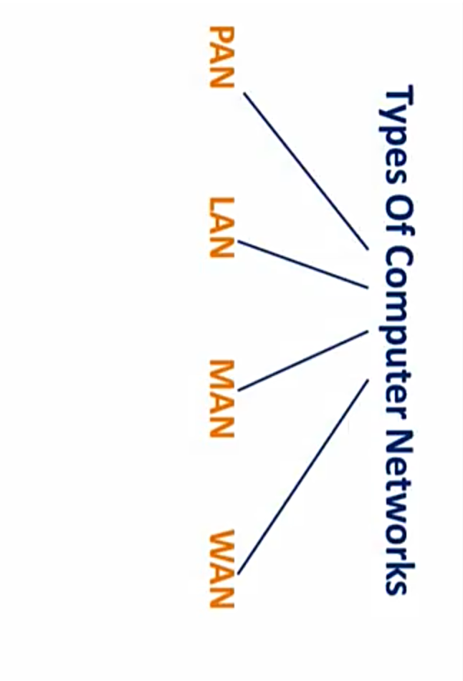
What are the types of network?
Following are the well known types of Network.

Slide 7
1) PAN (personal area network)
It is a smallest network which is very personal to a user.
Range 10 meters
Examples: keyboard ,mouse ,printer , scanner, Bluetooth ,zapya and tv remotes….

Slide 8
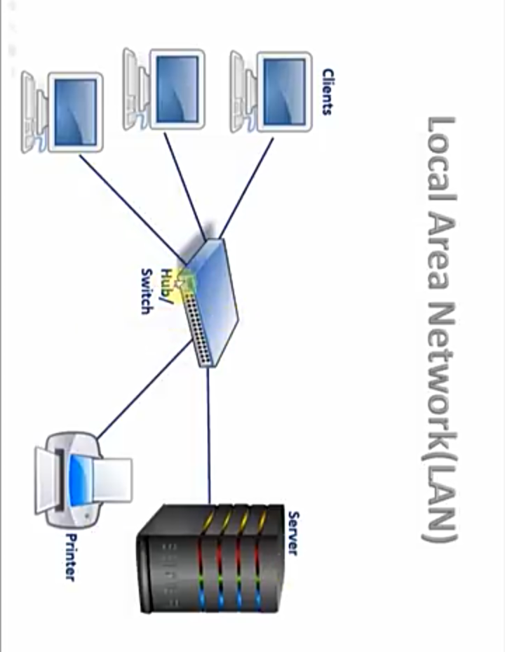
2) LAN (local area network)
In LAN computer network computer are spinned inside a building and operated under single administrative system
It is used in organization ,offices ,schools ,colleges and universities.
Wired and wireless or both
For example : WIFI and intranet etc.

Slide 9
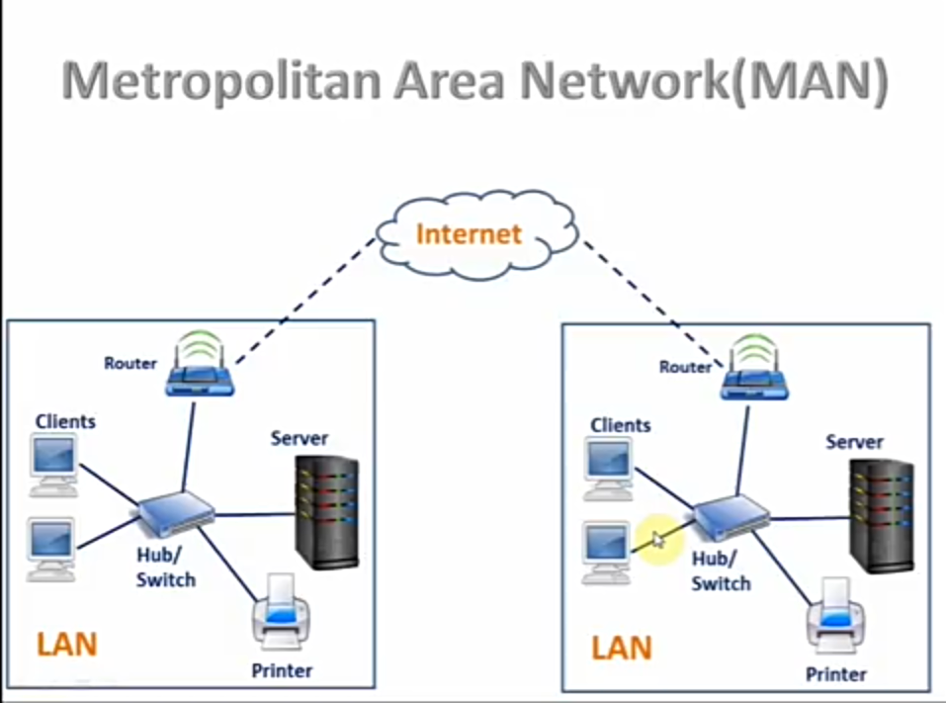
3) MAN (metropolitan area network)
This computer network expands throughout a city such as cable tv, landline telephone network etc.
It is group of LAN networks.

Slide 10
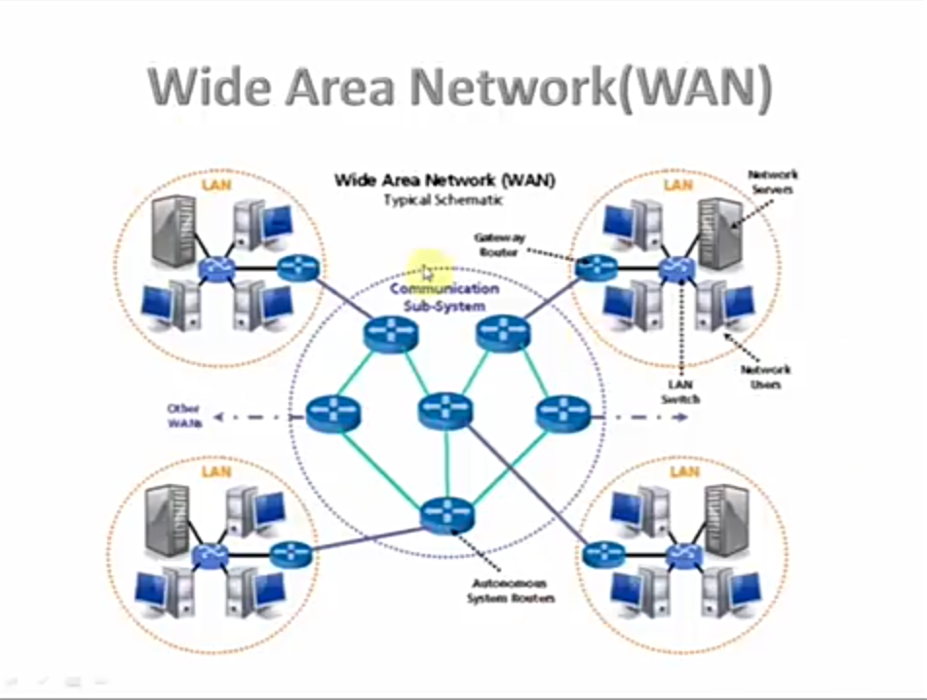
4) WAN (wide area network)
WAN is used for communication b/w devices of a large geographical areas such as countries or continents by using satellites and cables systems.
WAN can contains multiples small networks such as LAN or MAN.

Slide 11
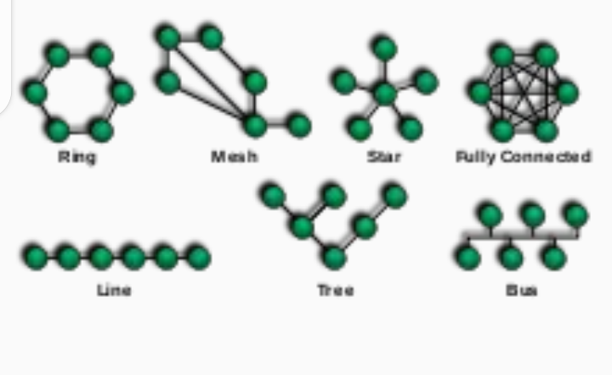
What is network topology?
It is arrangement which shows that how computer systems are connected to each other.
For examples.

Slide 12
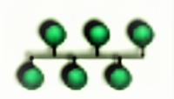
Bus topology:
All the computers share single communication line.
For example:
This is diagram of BUS topology in computer network…

Slide 13
ADVANTAGES OF BUS TOPOLOGY
It is the easiest network topology
It works very efficiently well when there is a small network.
The length of cable required is less.
It is easy to connect or remove devices in this network without affecting any other device.
Very cost-effective as compared to other network topology
It is easy to understand topology.
Easy to expand by joining the two cables together.

Slide 14
DISADVANTAGES
Bus topology is not great for large networks.
Troubleshooting individual device issues is very hard.
Need terminators are required at both ends of the main cable.
Additional devices slow the network down.
If the main cable is damaged, the whole network fails
network is very slow as compared to other topologies.

Slide 15
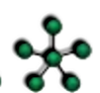

Star topology
All hosts computers are connected in the star shape to a device/hub for sharing information and resources with each other
For examples.

Slide 16
Advantages of Star Topology
It is very reliable – if one cable or device fails then all the others will still work
It is high-performing
Less expensive because each device only need one I/O port
Easier to put in
Easy fault detection because the link are often easily identified.
If N devices are connected to every other in star, then the amount of cables required to attach them is N. So, it’s easy to line up.

Slide 17
Disadvantages of Star Topology
Requires more cable than a linear bus .
If the connecting network device (network switch) fails, nodes attached are disabled and can’t participate in network communication.
More expensive
If hub goes down everything goes down, none of the devices can work without hub.
Hub requires more resources and regular maintenance because it’s the central system of star .

Slide 18
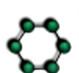
Ring topology
The structure like a ring in which the data travel through all the intermediate hosts.
For example.
The failure of any one host result in failure of whole system .

Slide 19
ADVANTAGES
It is cheap to install and expand.
Minimum collision.
Speed to transfer the data is very high in this type of topology.
Easy to manage.
Ring network is extremely orderly organized.
DISADVANTAGES OF RING TOPOLOGY :
If one workstation shuts down, it affects whole network or if a node goes down entire network goes down.
It is slower in performance as compared to the bus topology
It is Expensive.
Addition and removal of any node during a network is difficult and may cause issue in network activity.
Difficult to troubleshoot the ring.
In order for all the computer to communicate with each other, all computer must be turned on.
Total dependence in on one cable.
They were not Scalable.

Slide 20
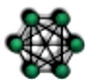
Mesh topology
It hosts in point to point and ring connection with every other hosts or may also have hosts to hosts only …
For example..

Slide 21
Advantages of Mesh Topology :
Failure during a single device won’t break the network.
There is no traffic problem as there is a dedicated point to point links for every computer.
It provides high privacy and security.
Data transmission is more consistent because failure doesn’t disrupt its processes.
Adding new devices won’t disrupt data transmissions.
A mesh doesn’t have a centralized authority.

Slide 22
Disadvantages of Mesh Topology :
It’s costly.
Installation is extremely difficult in the mesh.
Power requirement is higher
Complex process.
Maintenance needs are challenging with a mesh.

Slide 23
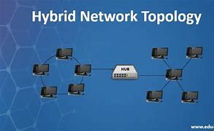
Hybrid Topology
A hybrid topology is a type of network topology that uses two or more differing network topologies.

Slide 24
ADVANTAGES OF HYBRID TOPOLOGY:
Can be modified as per requirement.
It is extremely flexible.
It is very reliable.
It is easily scalable
Error detecting and troubleshooting are easy.
Handles a large volume of traffic.
It is used to create large networks.
The speed of the topology becomes fast when two topologies are put together.

Slide 25
DISADVANTAGES OF HYBRID TOPOLOGY :
It is a type of network expensive.
The design of a hybrid network is very complex.
There is a change in the hardware to connect one topology with another topology.
Installation is a difficult process.

Slide 26
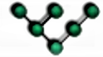

Tree topology
In this type of topology devices are connected with each other like a tree shape ..

Slide 27
ADVANTAGES OF TREE TOPOLOGY :
This topology provides a hierarchical as well as central data arrangement of the nodes.
network are not affected if one of their nodes gets damaged or does not work.
Tree topology provides easy maintenance and easy fault identification can be done.
Tree Topology is highly secure.
It is used in WAN.
Tree Topology is reliable.

Slide 28
DISADVANTAGES OF TREE TOPOLOGY :
Due to the presence of a large number of nodes, the network performance of tree topology becomes a bit slow.
Treatment of the topology is pretty complex.
The establishment cost increases as well.

Slide 29
WHICH TOPOLOGY IS THE BEST ?
There is no definitive answer to this question.
as it depends on the specific requirements of the network and the resources available.
However, some common topologies that are often considered to be effective include the star topology.

Slide 30

Disadvantages of NETWORKING: In my point there are two major disadvantages of networking.
1)Networking provide a link to the hacker to hack data..

Slide 31

2) The human spend lot of time on computers because of networking so they waste their time in extra activities and health…

Slide 32

How to protect myself from networking hacking ?
You can protect your from hacking by following these steps:
1)delete vidmate and Olx from your mobile
2)always use chrome browser
3)Make sure that there is a anti virus in your mobile
4)don’t log in your account in different devices
5)before purchasing mobile restore at least three times and full its memory.
6) avoid to click this type of messages

Slide 33



